Slide 1
01
SOFTWARE
PROJECT
LAB
NAME : EFFAZ RAYHAN
ROLL : BSSE 1501
SUPERVISOR : DR. MD NURUL AHAD TAWHID

Slide 2
Project Description
Connecto
A Client-Server Based Chatting Application
The secure chat room application is a client-server based chat system that enables multiple users to communicate securely.

Slide 3
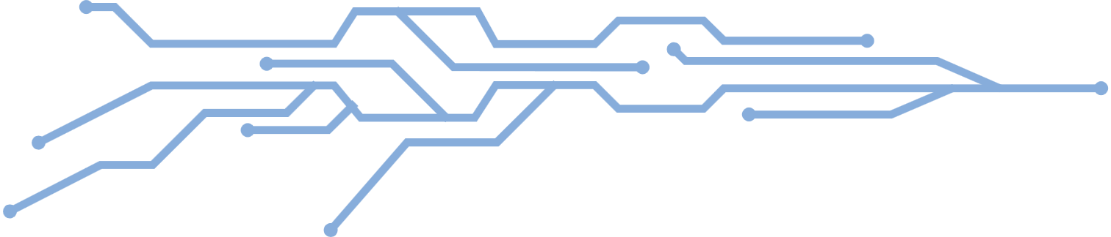
Project Description
Secure
03
HIGHLIGHTED
FEATURES
Chat room
Client-Server

Slide 4
Project Description
ONLINE AVAILABILITY CHECKING
MULTIPLE CHAT ROOMS
OTHER
FEATURES
OLD CHAT GENERATION

Slide 5
WORKING METHODOLOGY
SOCKET PROGRAMMING
SHA-256 HASHING ALGORITHM
TERMINAL BASED
EASY USER INTERFACE

Slide 6
PROGRESS
DASHBOARD
SIGNUP
LOGIN
USERNAME
PASSWORD
USERNAME
PASSWORD
DATABASE
DATABASE
(IF EXIST)
(IF !EXIST)
HASH
( SHA-256 )
GET TOKEN
GENERATE
TOKEN
HASH
( SHA-256 )
MATCHES IN FILE
STORED IN FILE
SIGNUP SUCCESSFUL
LOGIN SUCCESSFUL

Slide 7
PROGRESS
LOGIN SUCCESSFUL
CREATE CHAT ROOM
JOIN CHAT ROOM
ROOM ID
ROOM PASSWORD
ROOM ID
ROOM PASSWORD
GENERATE ROOM ID
CHECKED IN SERVER LOG
HASH
( SHA-256 )
HASH
( SHA-256 )
STORED IN SERVER LOG
MATCHED
LOGGED INTO CHATROOM

Slide 8
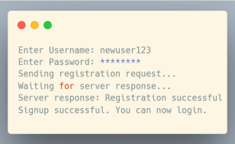
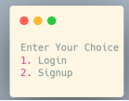
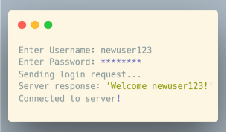
PROGRESS
CLIENT INITIALIZATION
3. USER LOGIN
2. USER SIGNUP

Slide 9
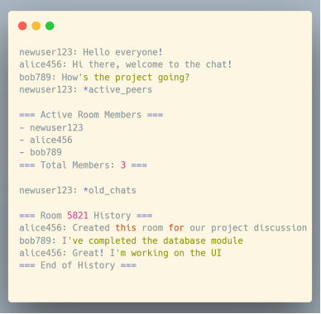
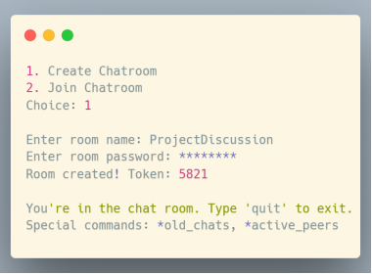
PROGRESS
5. JOIN CHATROOM
4. CREATE CHATROOM

Slide 10
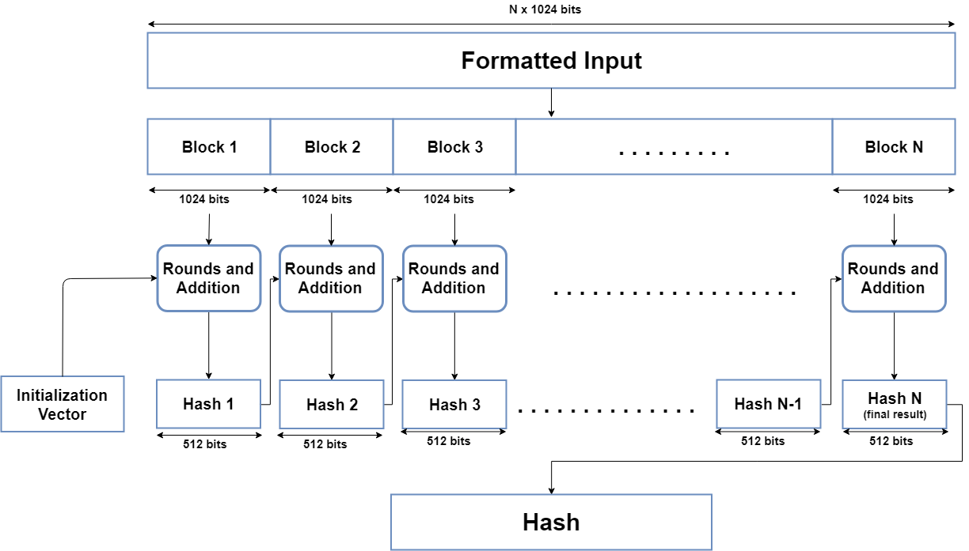
PROGRESS - PASSWORD HASHING
SHA
256

Slide 11
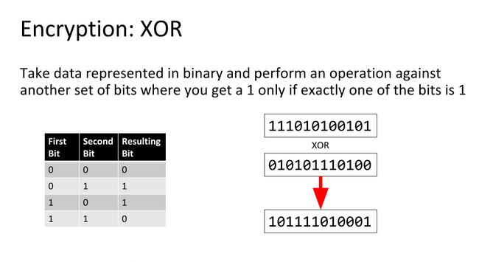
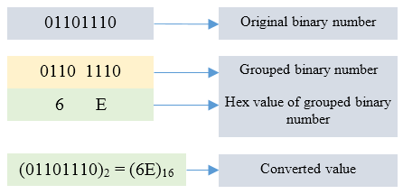
PROGRESS - DATA ENC AND DEC
SHA
512

Slide 12

CHALLENGES

Slide 13
CHALLENGES
CHALLENGES SO FAR
First Time Working on a Big Project
Explore Socket Programming
Study encryption and decryption algorithms
Implement RAW SHA-256 code
Implement Raw XOR&HEX encdec code
Learn MultiThreading
Implement Secure Encryption Algorithm For Secure Communication
Merge The Dashboard with server-client

Slide 14
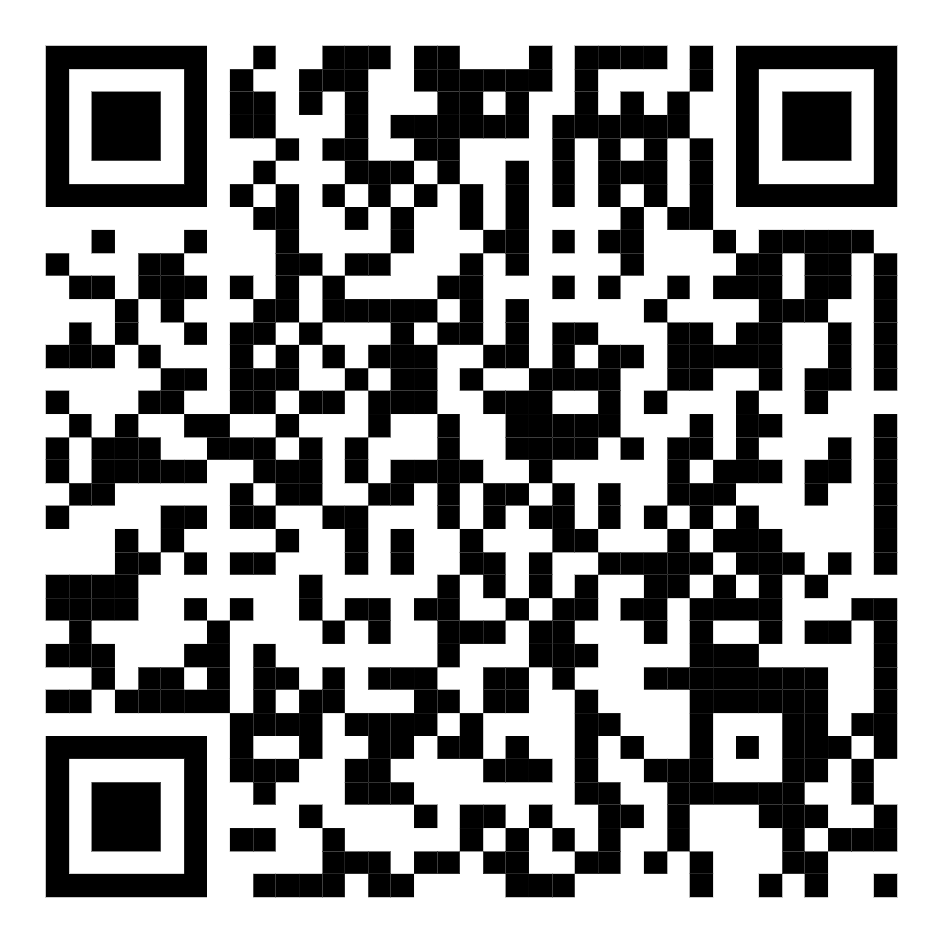
THANK YOU
NAME : EFFAZ RAYHAN
ROLL : BSSE 1501
MY GITHUB REPOSITORY :
https://github.com/effazrayhan/spl_one

